Slide 1
12. Deep Learning - RNN

Slide 2
recurrent Neural Networks

Slide 3
Introduction
RNNs
A family of neural networks processing sequential data, such as,
a sequence of values x⁽¹⁾, . . . , x^{(τ)}
can scale to much longer sequences, e.g.,
text
Voice
…

Slide 4
Sequential Data
Sequence data is any data where the order matters
text data
protein/gene sequences
sequential patterns: e.g., sequences of purchases
timeseries
stock prices
amount of precipitation
ECG data
music
audio data
trajectories
video

Slide 5
Recurrent Neural Networks
Recurrent neural networks (RNNs) are a family of neural networks for processing sequential data:
they can scale to much longer sequences than would be practical for networks without sequence-aware units
most recurrent networks can process sequences of variable length

Slide 6
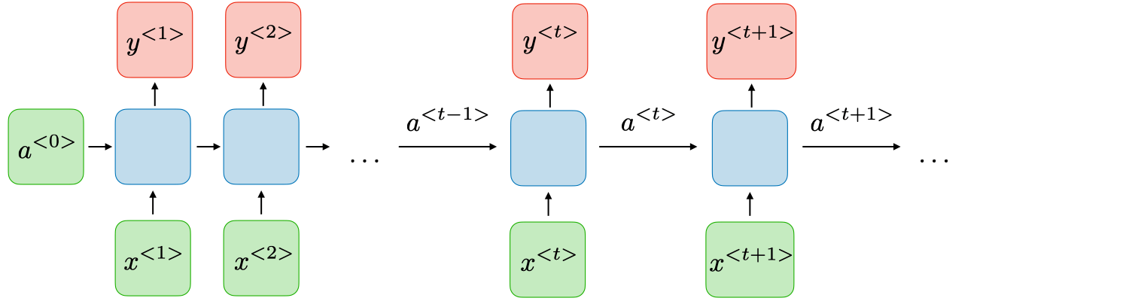
Recurrent Neural Networks
RNNs allow previous outputs to be used as inputs while also having hidden units. A high-level RNN architecture is as follows:
h^{<0>}
h^{< t-1 >}
h^{< t >}
h^{< t+1 >}

Slide 7
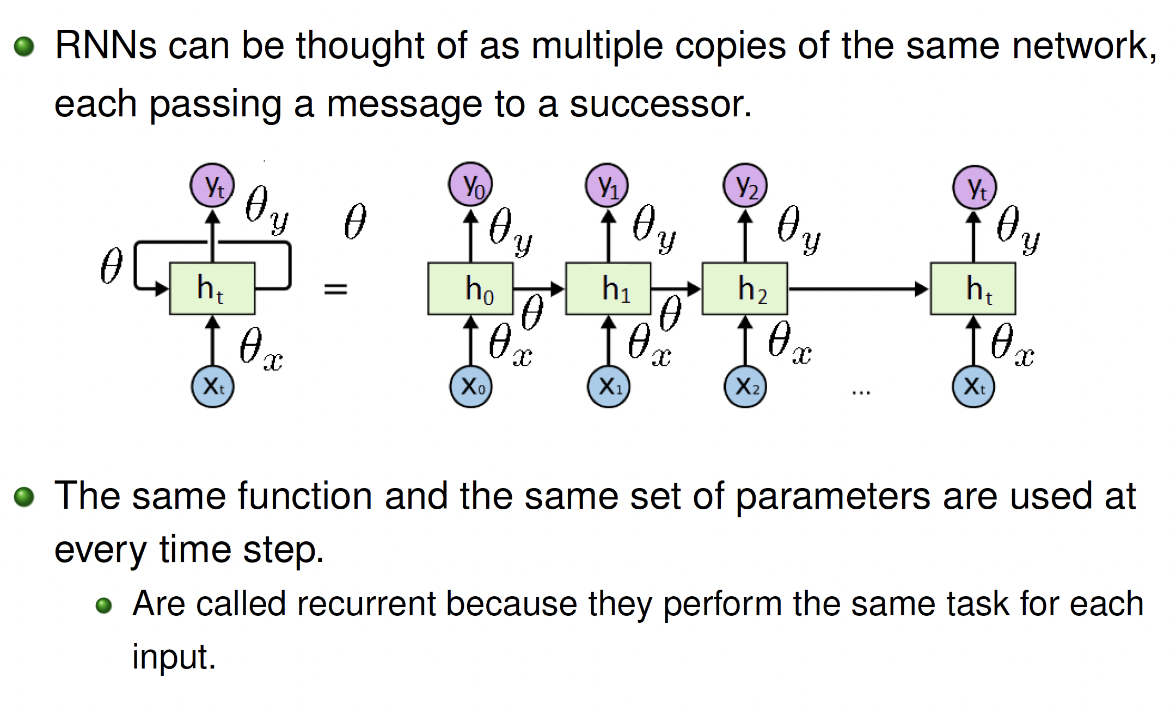
Recurrent Neural Networks

Slide 8

Unfolding computational graphs
Unfolding a recursive or recurrent computation into a computational graph that has a repetitive structure
Consider the classical form of a dynamical system
$$s^{(t)}=f(s^{\left(t−1\right)};θ)$$
Next state
State
Parameters to be learnt
It is recurrent because the definition of s at time t refers back to the same definition at time t − 1

Slide 9


How to unfold the system
For example, if we unfold the system for τ = 3 time steps, we obtain
$s^{(3)}=f\left(s^{\left(2\right)};θ\right)=$ $f\left(f\left(s^{\left(1\right)};θ\right);θ\right)$
They are shared
For a finite number of time steps τ, the graph can be unfolded by applying the definition τ − 1 times
$$s^{(t)}=f\left(s^{\left(t−1\right)},x^{(t)};θ\right)$$

Slide 10

How to unfold the system
Unfolding the equation by repeatedly applying the definition in this way has yielded an expression that does not involve recurrence.
Such an expression can now be represented by a traditional directed acyclic computational graph.
s^{(…)}
f
s^{(t-1)}
f
s^{(t)}
f
s^{(t+1)}
f
s⁽$τ$⁾

Slide 11


With external signal
a dynamical system driven by an external signal x^{(t)}
$$s^{(t)}=f\left(s^{\left(t−1\right)},x^{(t)};θ\right)$$
To indicate the state is the hidden units of the network, we use the variable h to represent the state
$$h^{(t)}=f\left(h^{\left(t−1\right)},x^{(t)};θ\right)$$
Typical RNNs will add extra architectural features such that output layers that read information out of the state h to make predictions

Slide 12
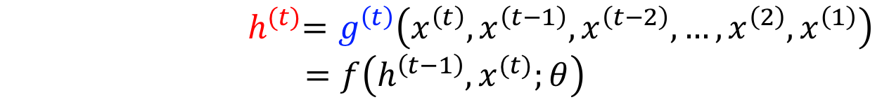
Lossy summary: hidden state h
It maps an arbitrary length sequence (x(t), x(t−1) , x(t−2), . . . , x(2) , x(1)) to a fixed length vector h(t)
$${ h}^{(t)}=g^{\left(t\right)}\left(x^{\left(t\right)},x^{\left(t−1\right)},x^{\left(t−2\right)},…,x^{\left(2\right)},x^{\left(1\right)}\right)$$
$$=f\left(h^{\left(t−1\right)},x^{(t)};θ\right)$$
Depending on the training criterion, this summary might selectively keep some aspects of the past sequence with more precision than other aspects.

Slide 13

Two ways
Circuit diagram
unfolded computational graph
h^{(…)}
f
h^{(t-1)}
f
h^{(t)}
f
h^{(t+1)}
f
h⁽$τ$⁾
h
Unfold
x
x^{(t-1)}
x^{(t)}
x^{(t+1)}
a delay of a single time step
associated with one particular time instance

Slide 14
Advantages
Sharing parameters across different parts of a model:
extend and apply the model to examples of different forms (variable lengths)

Slide 15
Advantages
The recurrent graph is succinct.
The unfolded graph:
provides an explicit description of which computations to perform.
helps to illustrate the idea of information flow forward in time (computing outputs and losses)
backward in time (computing gradients) by explicitly showing the path along which this information flows

